Slide 1

Revised Concept
Oliver Lewis – U1961638
Video & Post production
9/3/20XX
Presentation Title
2
Notes:
1

Slide 2
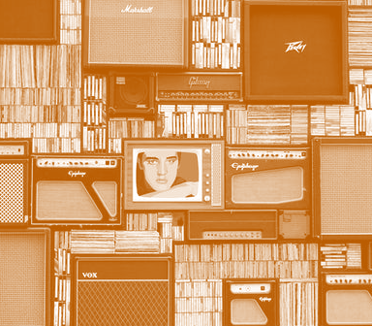
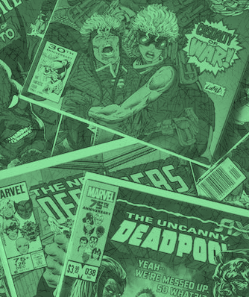
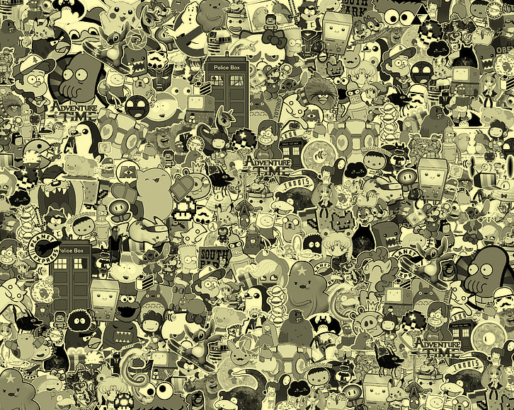
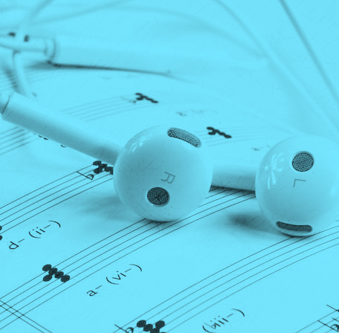
Concept
Rundown
mood boards of visual inspiration / references.
2-column script (1. Text/audio and 2.Describe the action)
12-20 frame storyboard - use bold shapes and clear indicators of movement. Presentation is key.
style frames illustrating the visual design of the intended video.
Presentation Title
Notes:
2

Slide 3
Agenda
With PowerPoint, you can create presentations and share your work with others, wherever they are. Type the text you want here to get started. You can also add images, art, and videos on this template. Save to OneDrive and access your presentations from your computer, tablet, or phone.
9/3/20XX
Presentation Title
3
Notes:
3

Slide 4
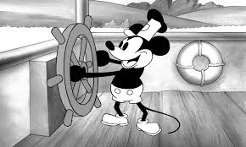
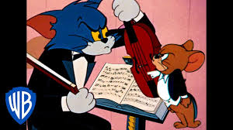

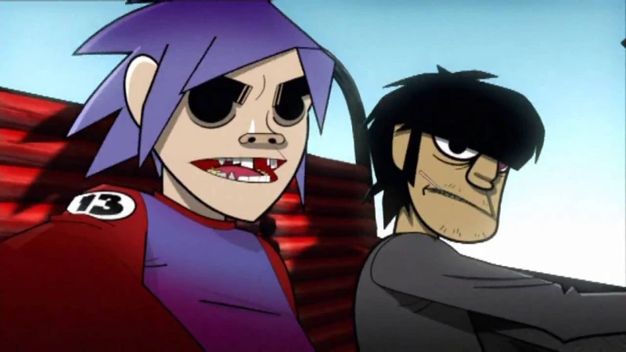
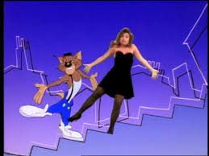
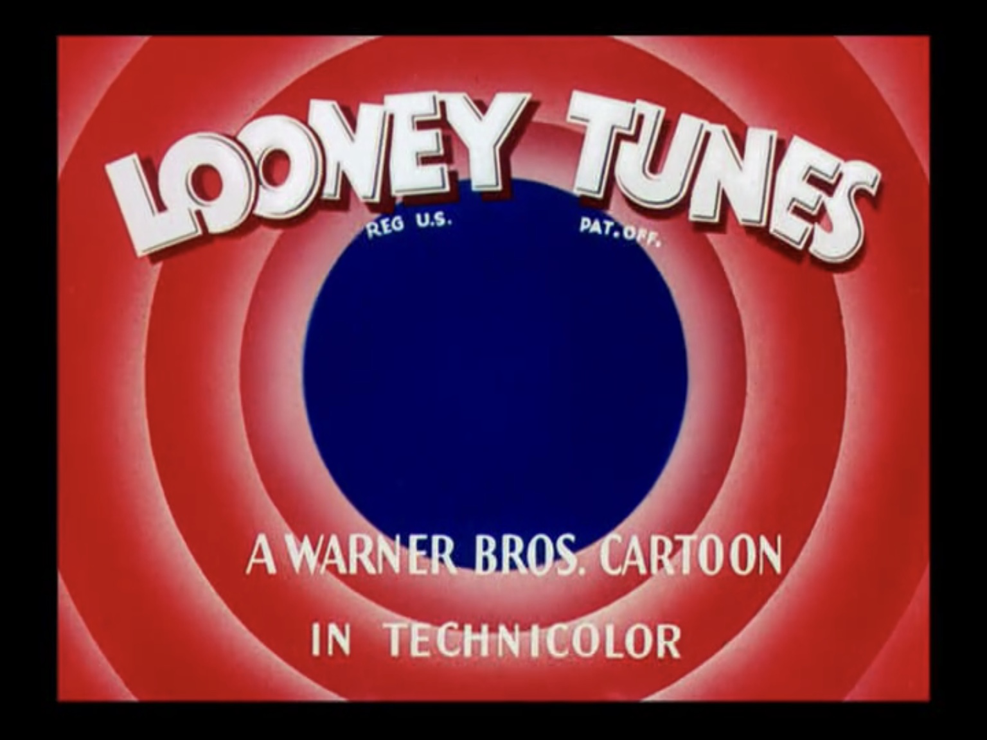

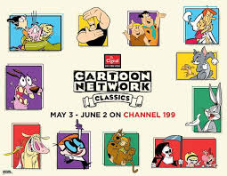
Inspirations
Gathering inspirations from a number of sources to come up with the original idea, the three main sources being: music videos, classic cartoons and pre-existing streaming services.
9/3/20XX
Presentation Title
5
Notes:
5

Slide 5
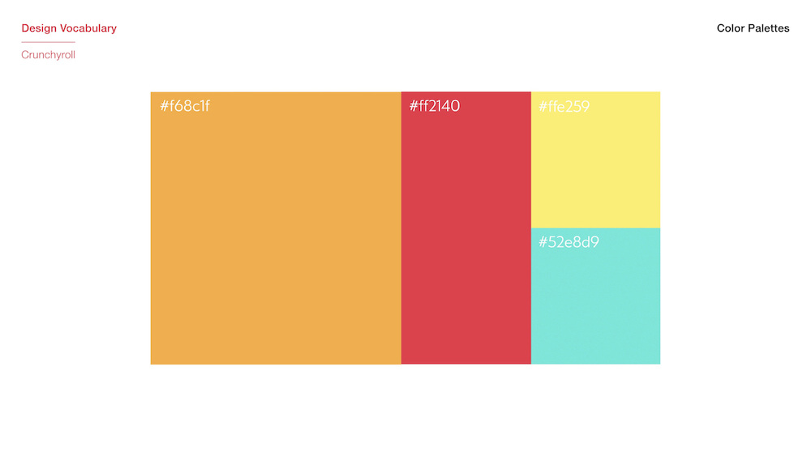
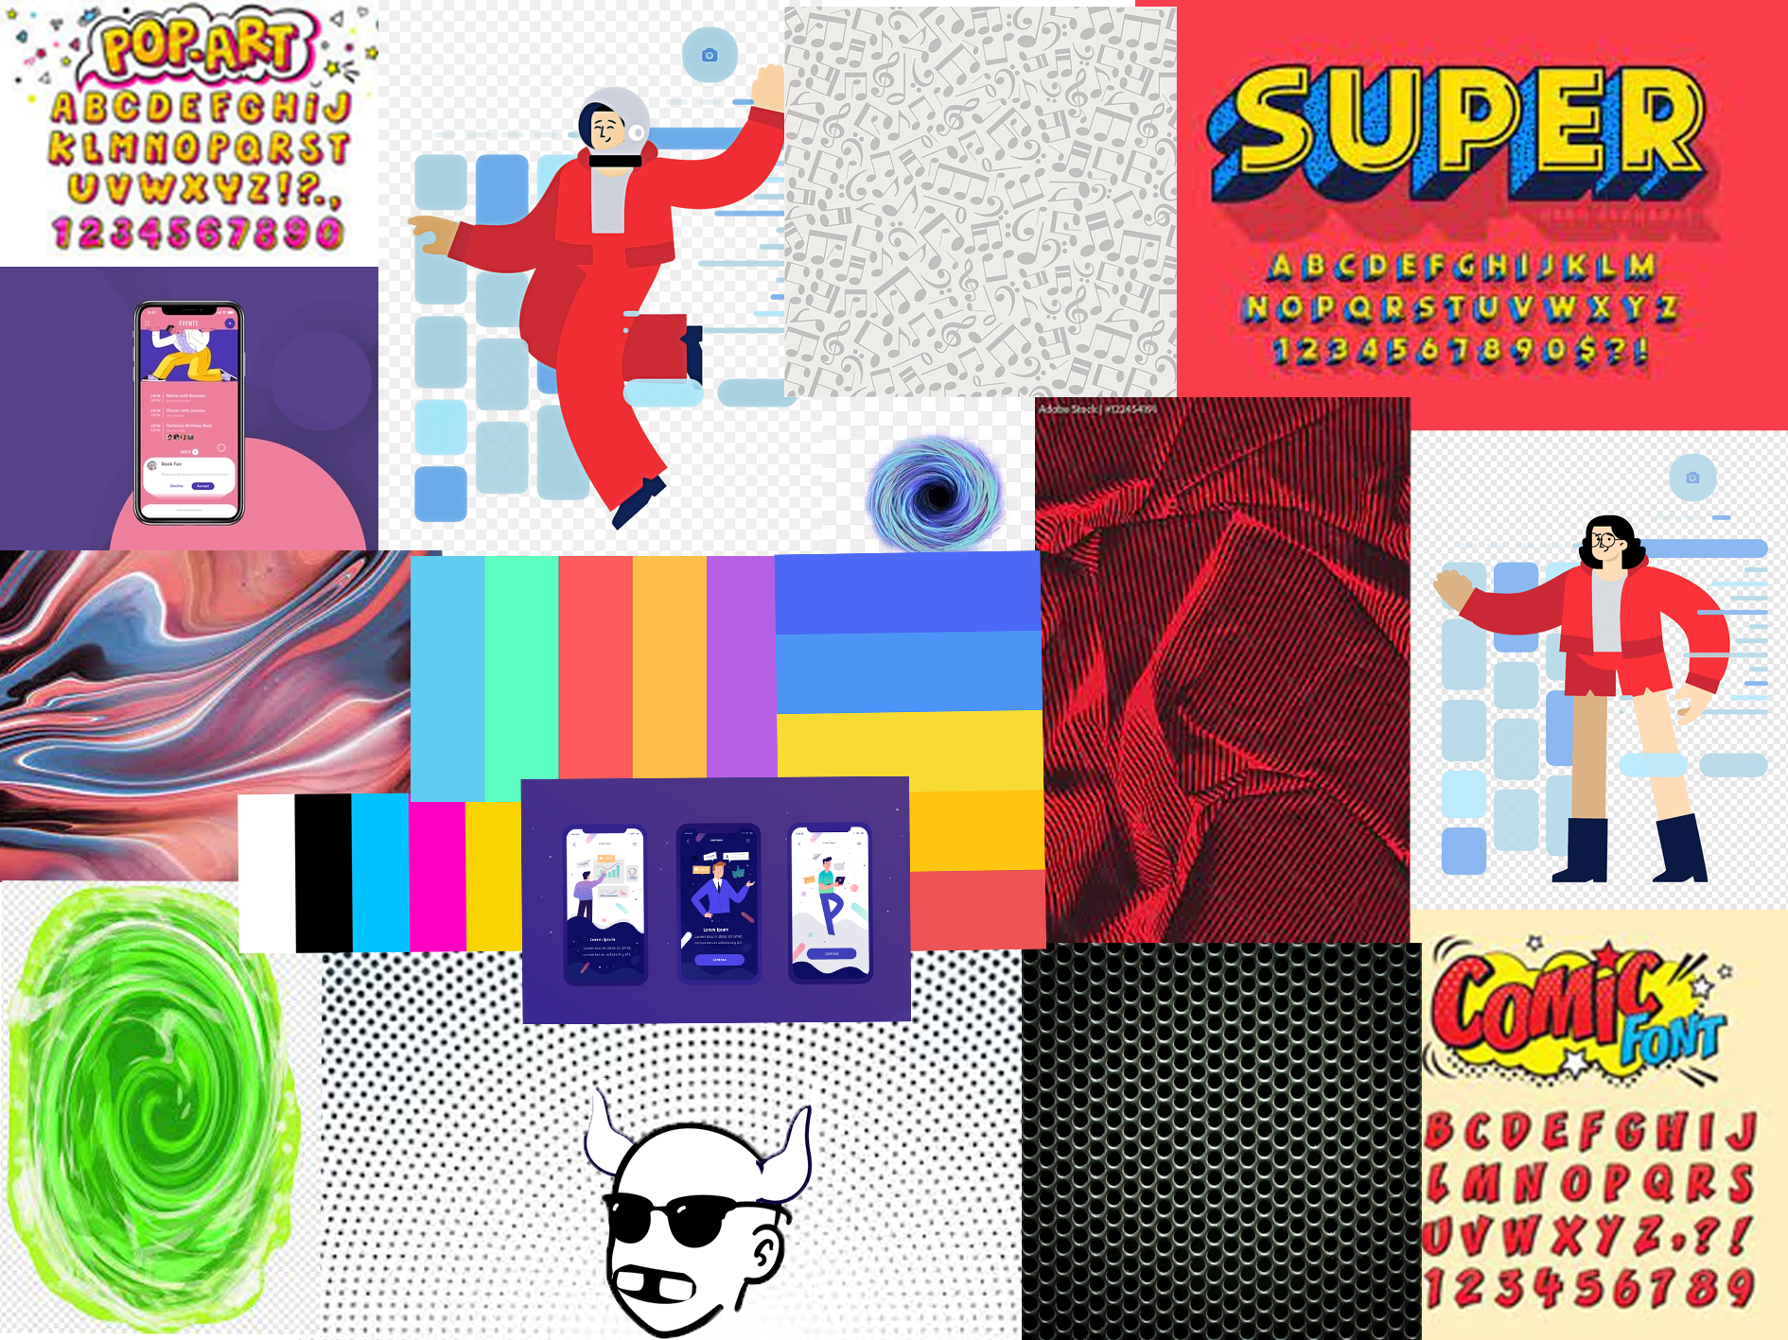

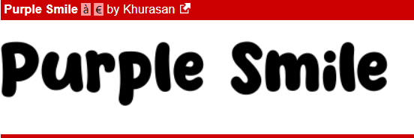
Mood board
Amalgamation of colour pallets, fonts, visual graphics, textures and layouts. Allowing for the generation of ideas for the overall and eventual look of the company.
9/3/20XX
Presentation Title
4
Notes:
4

Slide 6
Script
Text/Audio | Action/Description
Scene 1: Audio voice over - Bored of your regular rundown streaming service? | User/customer with a bored expression sitting watching television while camera lowers bringing them into view.
Scene 2: Audio - Up-beat music begins to play Voice over - Imagine if you could stream your favourite cartoons and music on one service | Change in emotional tone, characters expression increases to a smile as colour returns to the screen, slow zoom towards character and tv.
Scene 3: Text – “Do not attempt to adjust your television” Audio - Up-beat music continues | Change to characters point of view, looking towards the television as regular broadcast is taken over, via text appearing on the screen.
Scene 4: Text – “stay tooned” Audio - Up-beat music continues | Animated text flies in from the left and then the right telling the user to stay tuned for the advertisement they're about to be shown.
Scene 5: Audio - Up-beat music continues | Radial animation expands outwards from the television screen slowly engulfing the view of the camera.
Scene 6: Text – “Cartoons, sound tracks, theme songs, AMV’s, Music & Music videos” | Animated text drops down in order on the screen, listing the various features of that the streaming services will offer.
Text/Audio | Action/Description
Scene 7: Audio - Up-beat music continues | Transitional scene of radial circle shape animation receding inwards from previous scene.
Scene 8: Audio - Up-beat music continues | Users hand holding phone slides on screen from the left side, giving a close up of the mobile app in use.
Scene 9: Audio - Up-beat music continues | Point of view of user interaction with mobile phone, repeater animation exploding from phone when user presses buttons.
Scene 10: Audio - Up-beat music continues | Snap zoom towards mobile phone showcasing app features after user interacts with the app, zoom timed with interaction.
Scene 11: Audio - Up-beat music continues | Another radial animated transition scene, starting small in the centre of the screen extending outwards.
Scene 12: Text – “Toons” Audio - Up-beat music continues | Toons logo drops down from above the screen, while a hand holding a phone presenting the mobile app towards the camera, with animations in the background and overlayed.
9/3/20XX
6
Notes:
6

Slide 7
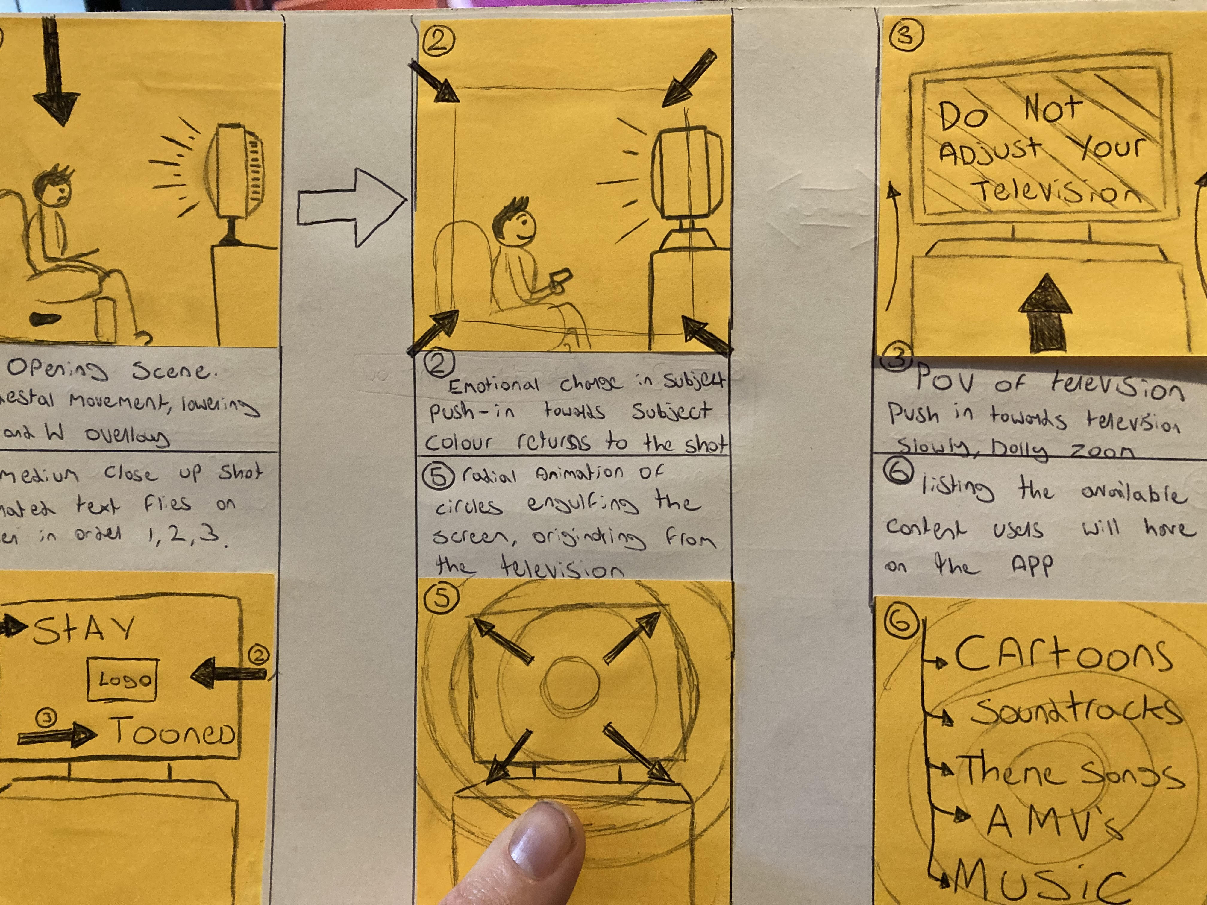
Storyboard
4
Notes:
4

Slide 8
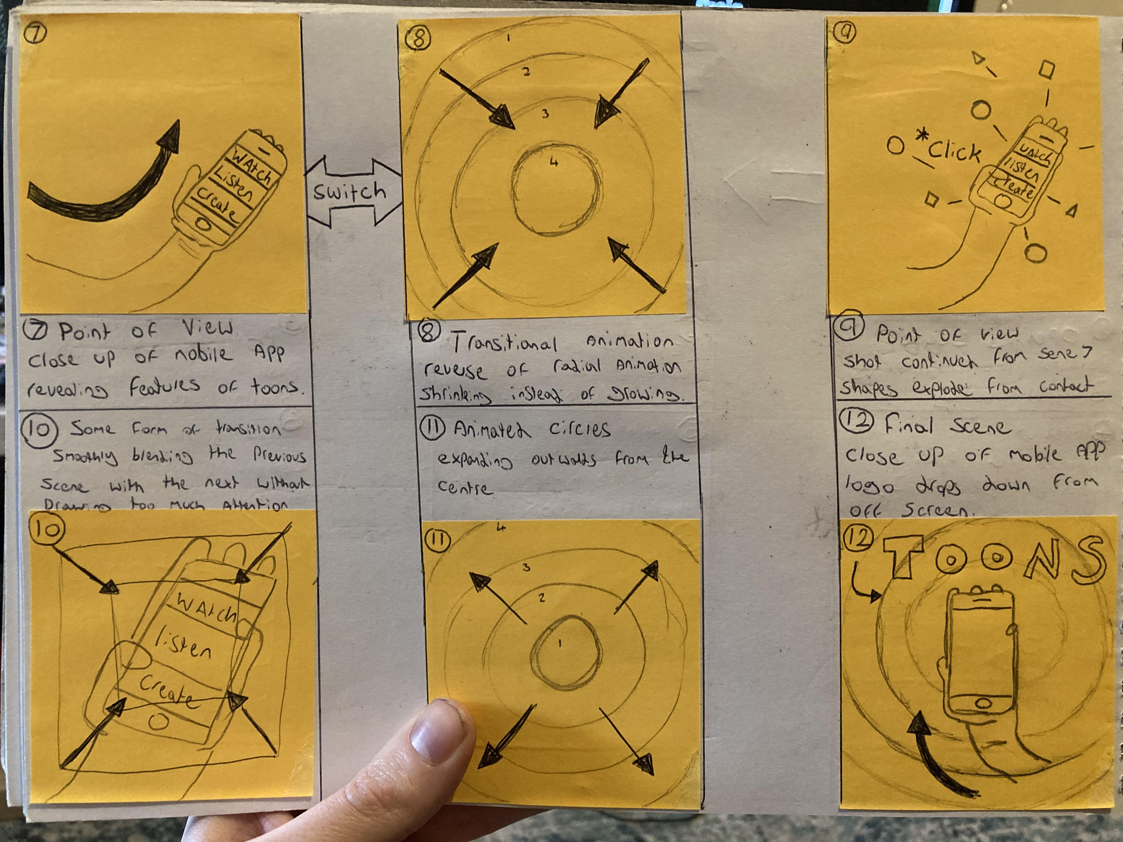
Storyboard
9/3/20XX
Presentation Title
6
Notes:
6

Slide 9
The way to get started is to quit talking and begin doing.
Walt Disney
9/3/20XX
Presentation Title
7
Notes:
7

Slide 10





Team
Name
Name
Name
Name
Name
Title
Title
Title
Title
Title
9/3/20XX
Presentation Title
8
Notes:
8

Slide 11

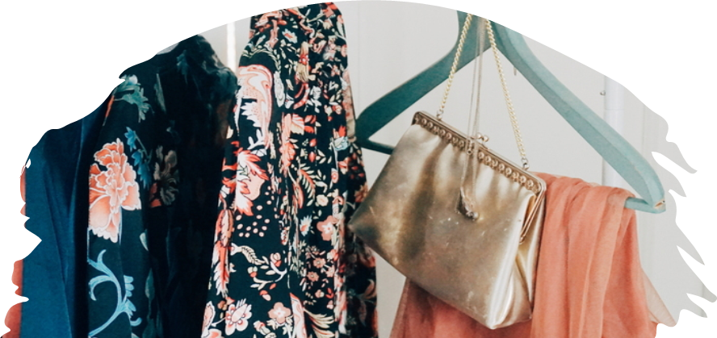
Summary
With PowerPoint, you can create presentations and share your work with others, wherever they are. Type the text you want here to get started. You can also add images, art, and videos on this template. Save to OneDrive and access your presentations from your computer, tablet, or phone.
Presentation Title
12
Notes:
12

Slide 12
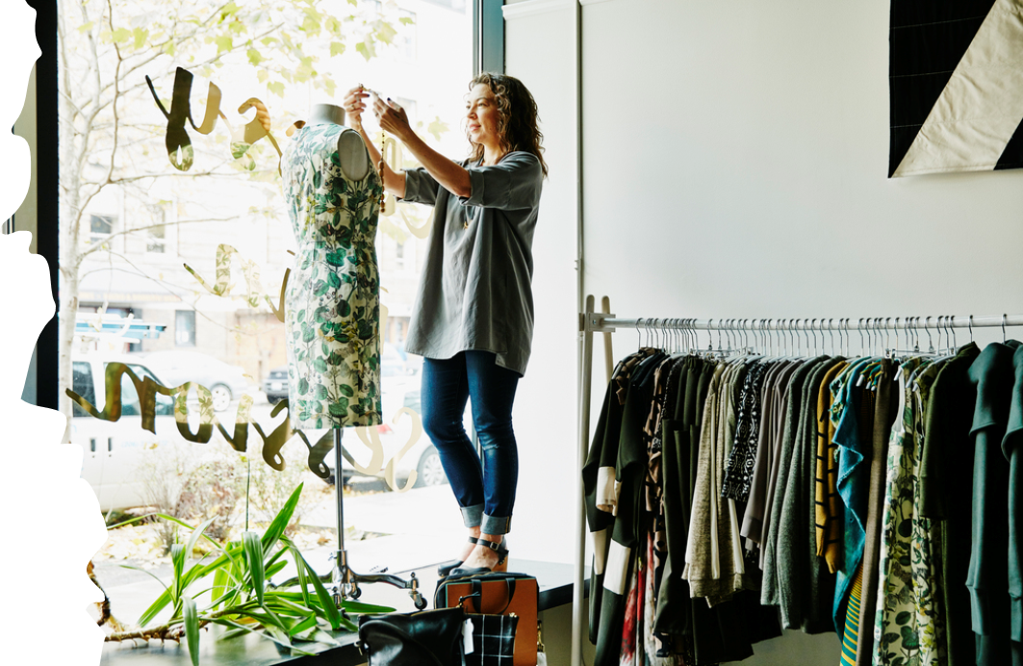

Thank you
Oliver Lewis
Video & Post production
Notes:
13

